Slide 1
Glaciers

Slide 2
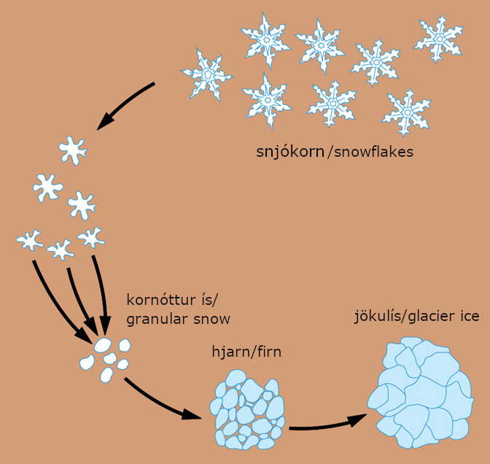
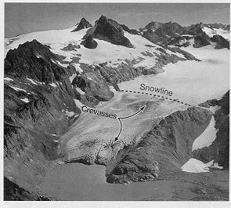
1. Glaciers
Video 4 min: https://www.youtube.com/watch?v=WJgpDyP9ewQ
a. How do glaciers form?
Snow accumulates over years, compressed into ice crystals called “firn”
b. Snowline
Lowest level that permanent snow reaches in the summer.

Slide 3
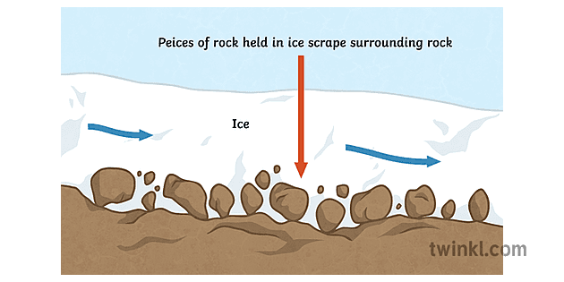
Glaciers
c. How do glaciers erode rocks?
Rocks embedded into the bottom and sides of glacier scratches the bedrock (plucking then abrasion)

Slide 4
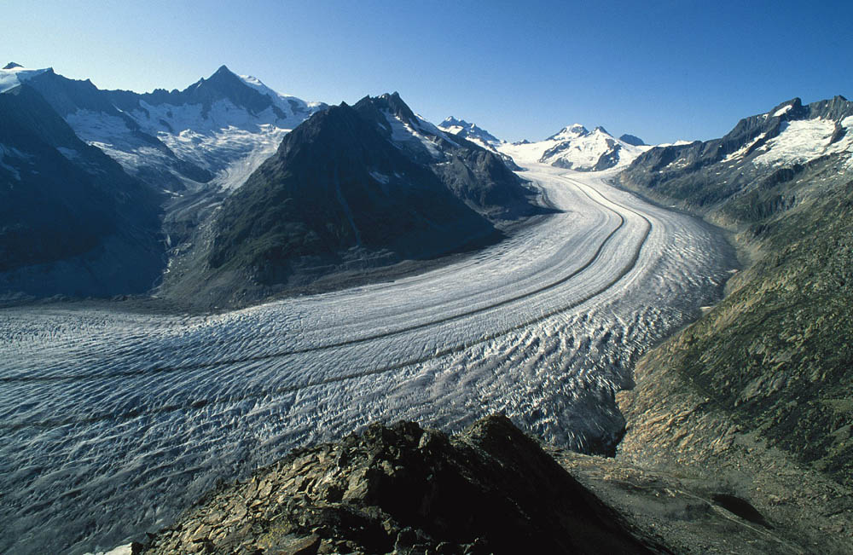
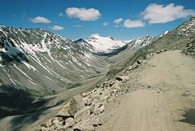
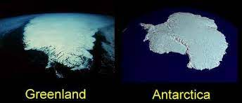
2. Types of Glaciers
a. Alpine or Valley Glacier – wedge-shaped stream of ice found in mountains. Forms U-shaped valleys.
b. Continental Glacier – moves outward from the centre as gravity squishes it. Covers large areas. Also called “Ice Sheet.”

Slide 5
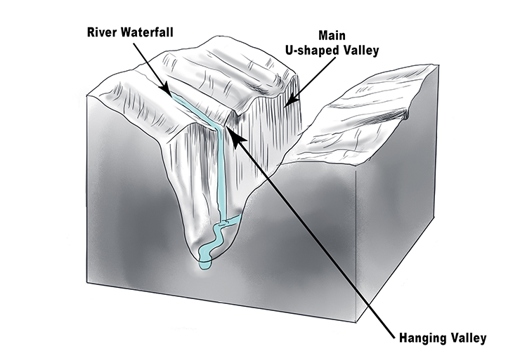
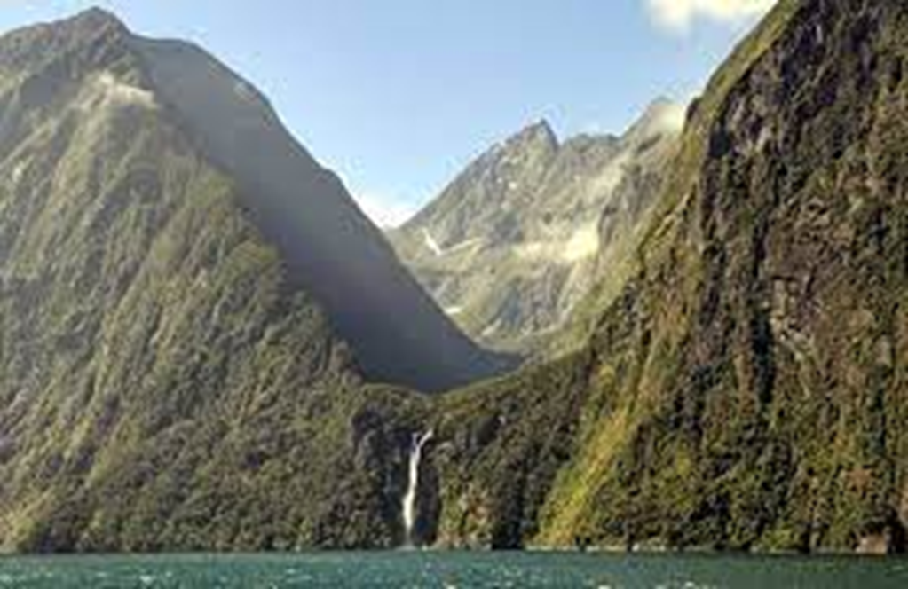
2c. Hanging Valley
Small tributary glacial valley that was cut off by a larger glacier. Often have waterfalls when glaciers melt.

Slide 6
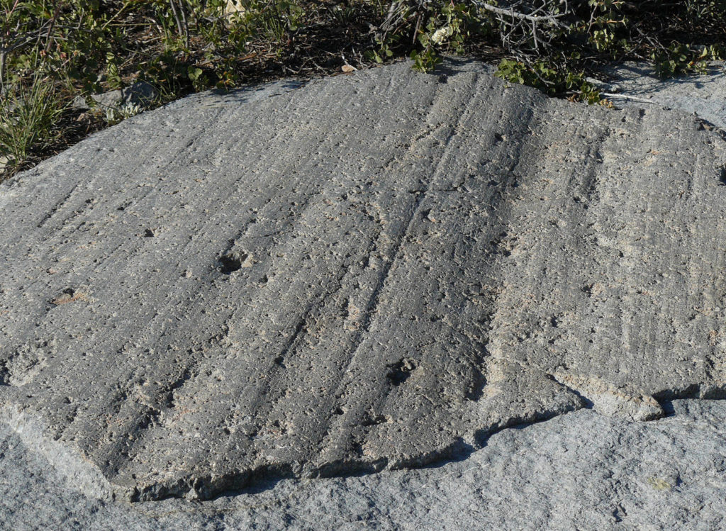
3. Erosional Features
Formed by glacier removing material
Striations – Long parallel scratches left by coarse sand, pebbles, sharp boulders that are imbedded in the ice and dragged over other rocks (bedrock)
They show the direction the glacier moved in.

Slide 7
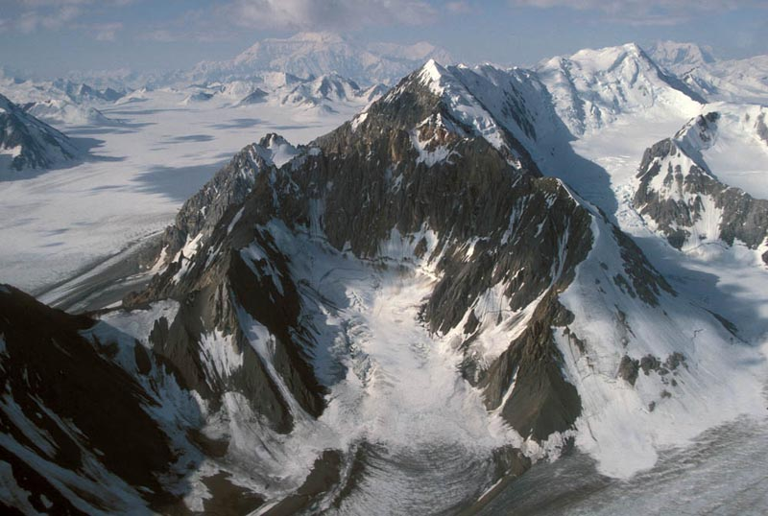
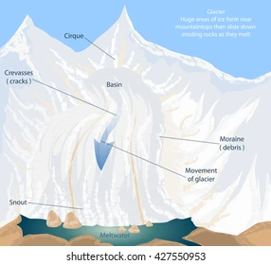
3. Erosional Features
b. Cirque – Semicircular basin formed at the head of a glacial valley by the glacier plucking away rocks as it moves downhill.

Slide 8
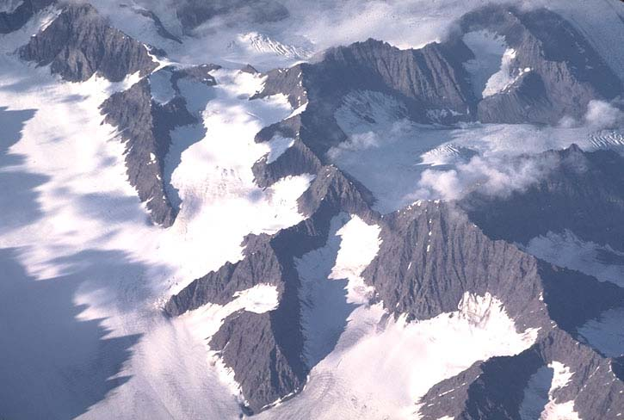
3. Erosional Features
c. Arete – knife-edged ridge between two cirques on a peak OR between two U-shaped valleys.

Slide 9
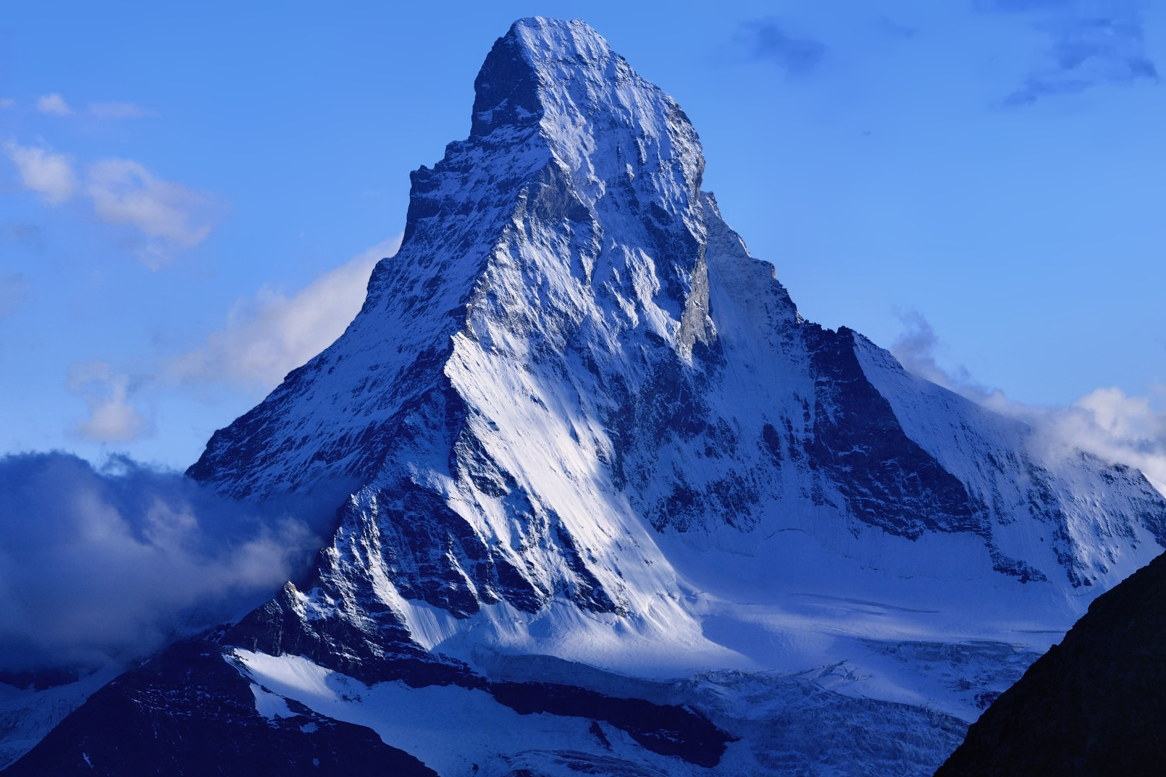
3. Erosional Features
d. Horn – formed by three or more glaciers sliding down from the peak of a mountain.

Slide 10
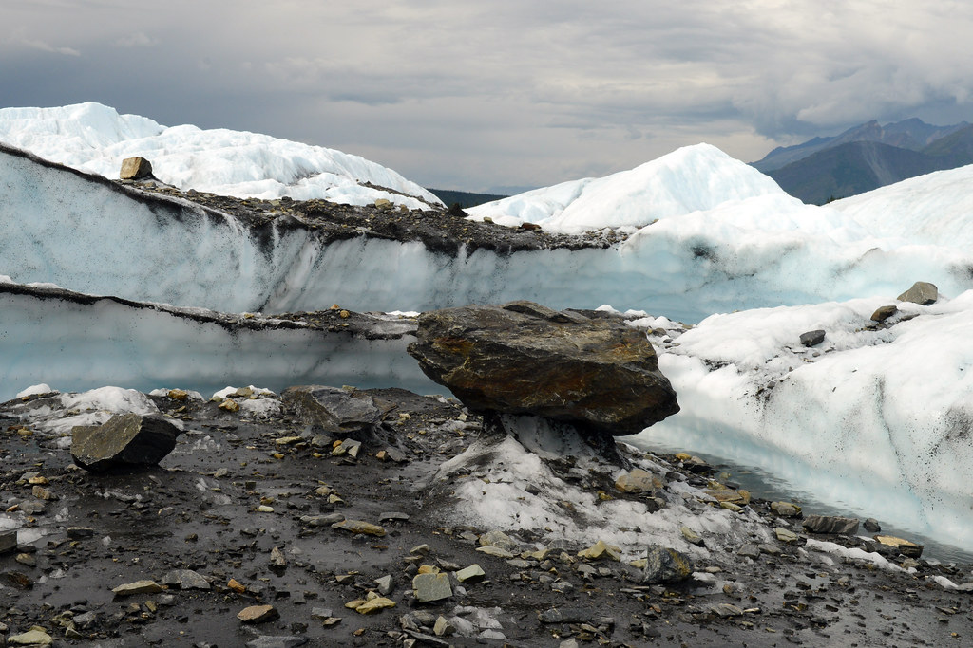
4. Depositional Features
Formed by glaciers depositing material (usually as the glacier melts)
a. Drift – all deposits of glacial origin are called this; the general term

Slide 11
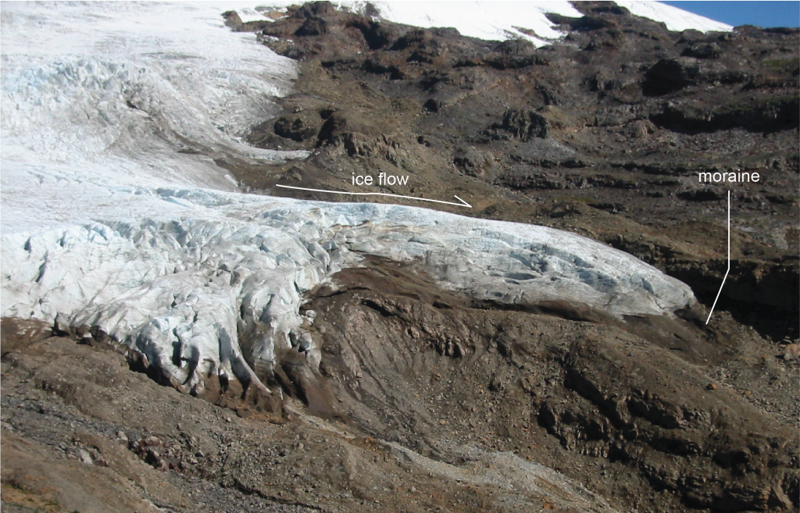
4. Depositional Features
b. Till or Ground Moraine – large buildups of rock pieces carried in the bottom of the glacier; deposits under the glacier; can become “tillite” if lithified into sedimentary rock.

Slide 12
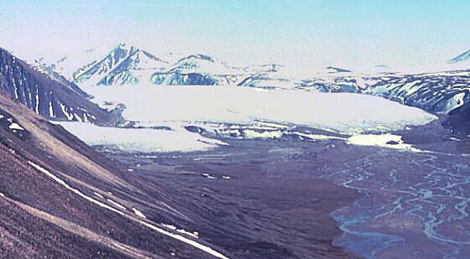
4. Depositional Features
c. Outwash – deposits made by streams of glacial meltwater; rounded particles; beyond furthest advance of glacier

Slide 13
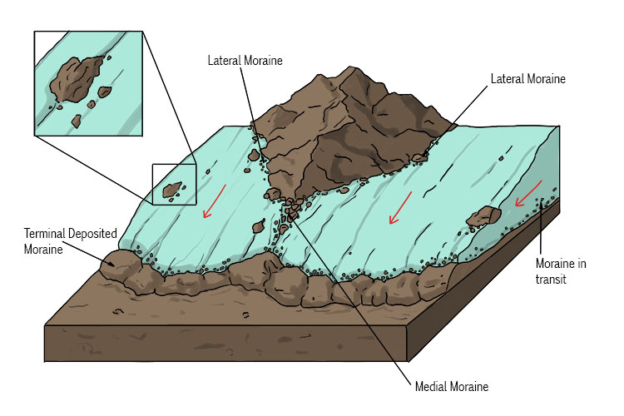
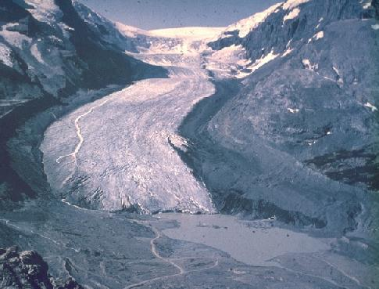
4d. Depositional Features: Moraines
Moraines are long lines of unstratified rocks. There are various types:
  i. Lateral Moraine: as a glacier moves down a valley, rocks from the valley walls fall onto the glacier. When the glacier melts, the rocks are deposited/dumped (unsorted and angular) along the sides of the valley

Slide 14
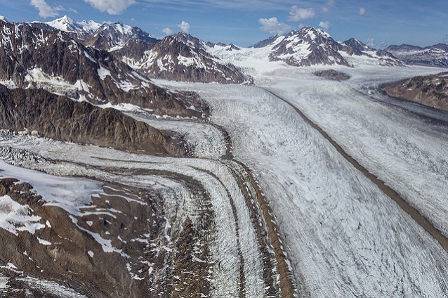
4d. Depositional Features: Moraines
  ii. Medial Moraine: If two glaciers from separate valleys join into one valley, the two central lateral moraines join to become one. When the glacier melts, the rocks are deposited in the middle of the valley.

Slide 15
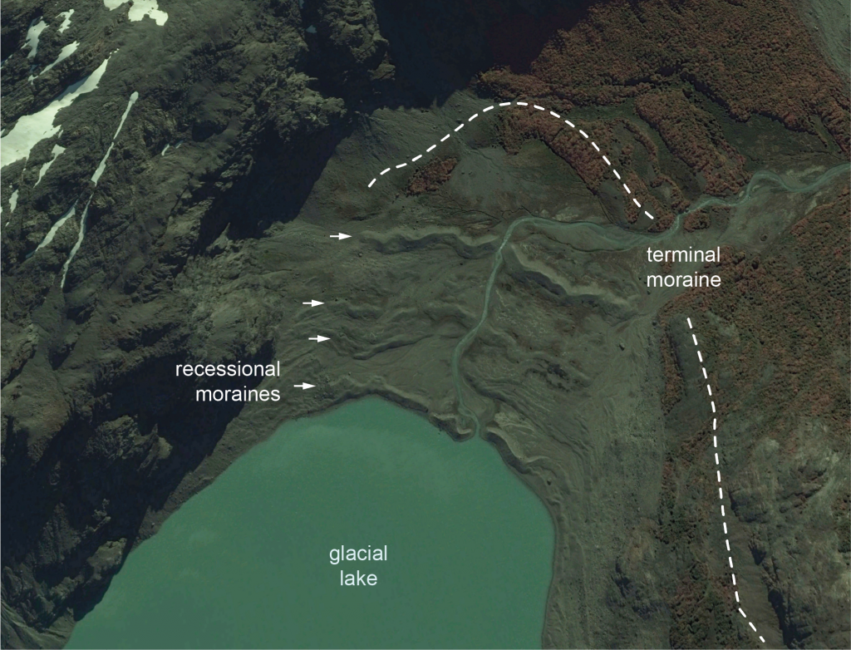
4d. Depositional Features Moraines
iii. End Moraines – formed at the end of a glacier. There are 2 types:
  1. Terminal – as a glacier moves it bulldozes material in front of it, making a line of rock at the toe, shows furthest advance
  2. Recessional – as a glacier “retreats” (melts faster than it moves forward) it may temporarily “stop” (melts at the same rate as it is moving forward) then all the rocks in the ice that is melting are deposited at that one spot.
Video 30s: https://www.youtube.com/watch?v=cgnAedIsplc

Slide 16
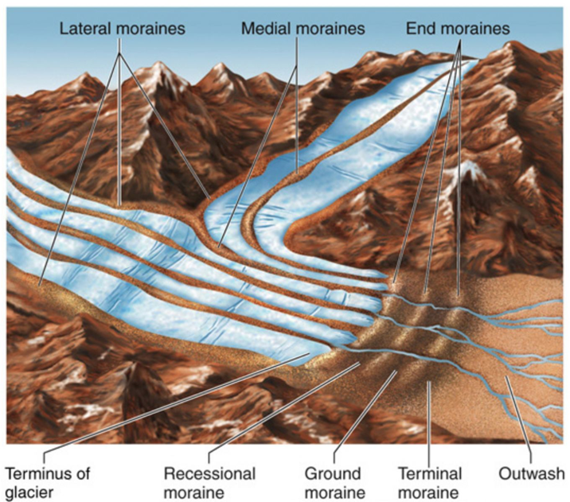
Depositional Features Moraines
Remember, moraines are deposited by the glacier, so are unsorted and angular pieces

Slide 17
PAUSE NOTES HERE
Practice questions from white and purple workbooks:
  White: pg 9 #1 erosional part, 4, 5, 7, 9, 10, 12, 15, 17, 18
  Purple: pg 22 # 1-5, 8-10, pg 23 # 1-14, 17-22

Slide 18
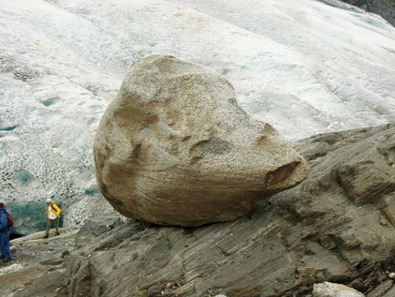
4. “more” Depositional Features
Video (3 min): https://www.youtube.com/watch?v=4hBtb4VgDLI
e. Erratic – large boulders that have been transported to an area by a glacier but don’t belong there (different rock type)

Slide 19
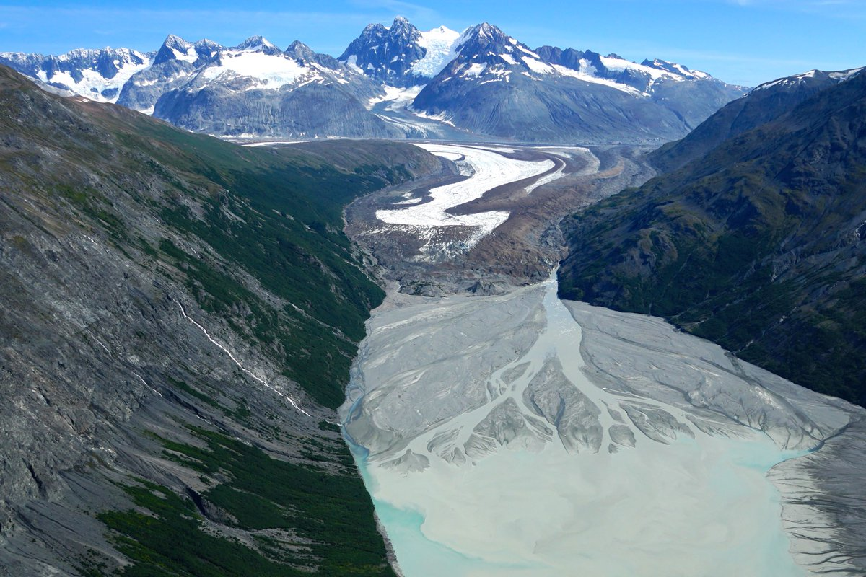
4. Depositional Features
f. Outwash Plain – glacial meltwater forms streams, from end of glacier – alluvial fans (deltas out of water) formed, overlap and form plains (rounded, sorted sediments)

Slide 20
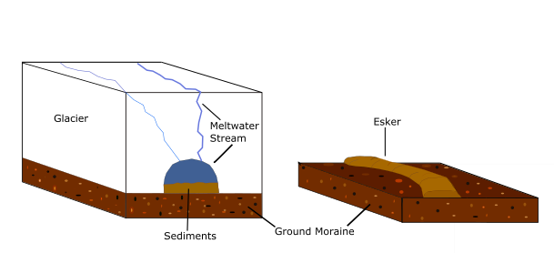
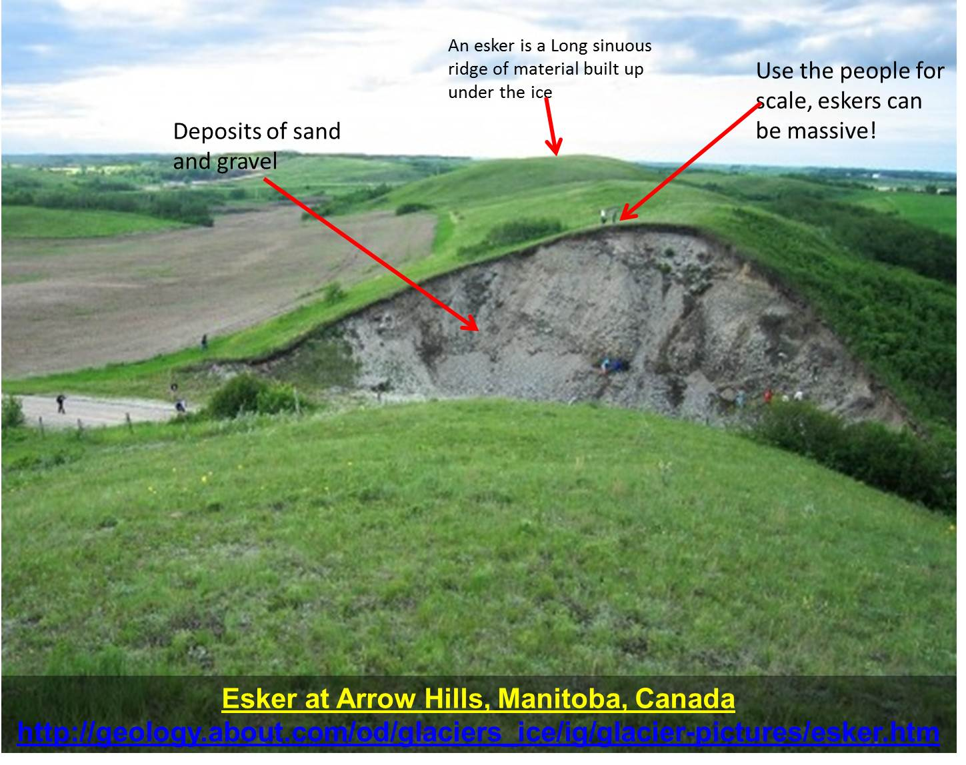
4. Depositional Features
g. Esker – meandering stream tunnels in or under glacier become partly filled with rocks. When glacier melts material is deposited in stratified s-shaped curves. These streams erode up since ice is softer than rocks below! (rounded, sorted, layered sediments)

Slide 21
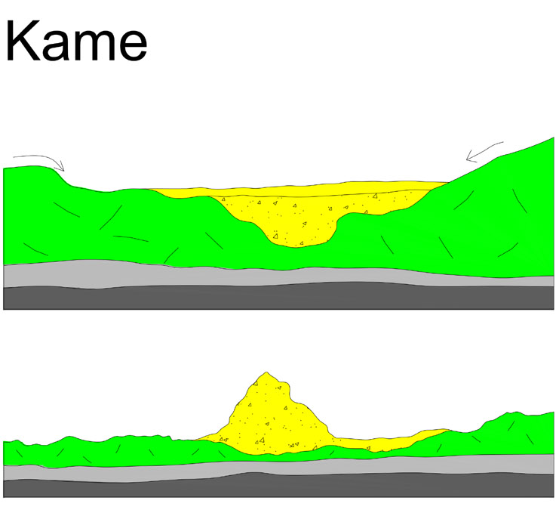
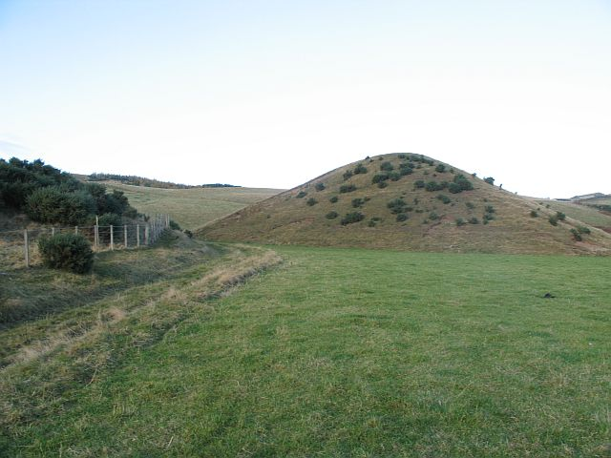
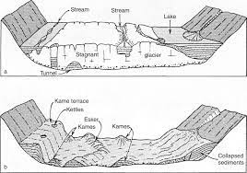
4. Depositional Features
h. Kame – cone-shaped hill formed when streams on top of glacier deposit rocks in lakes on top of glacier. When glacier melts, rocks deposited in stratified cone.
Kame Terrace – formed by streams/lakes along sides of glaciers

Slide 22
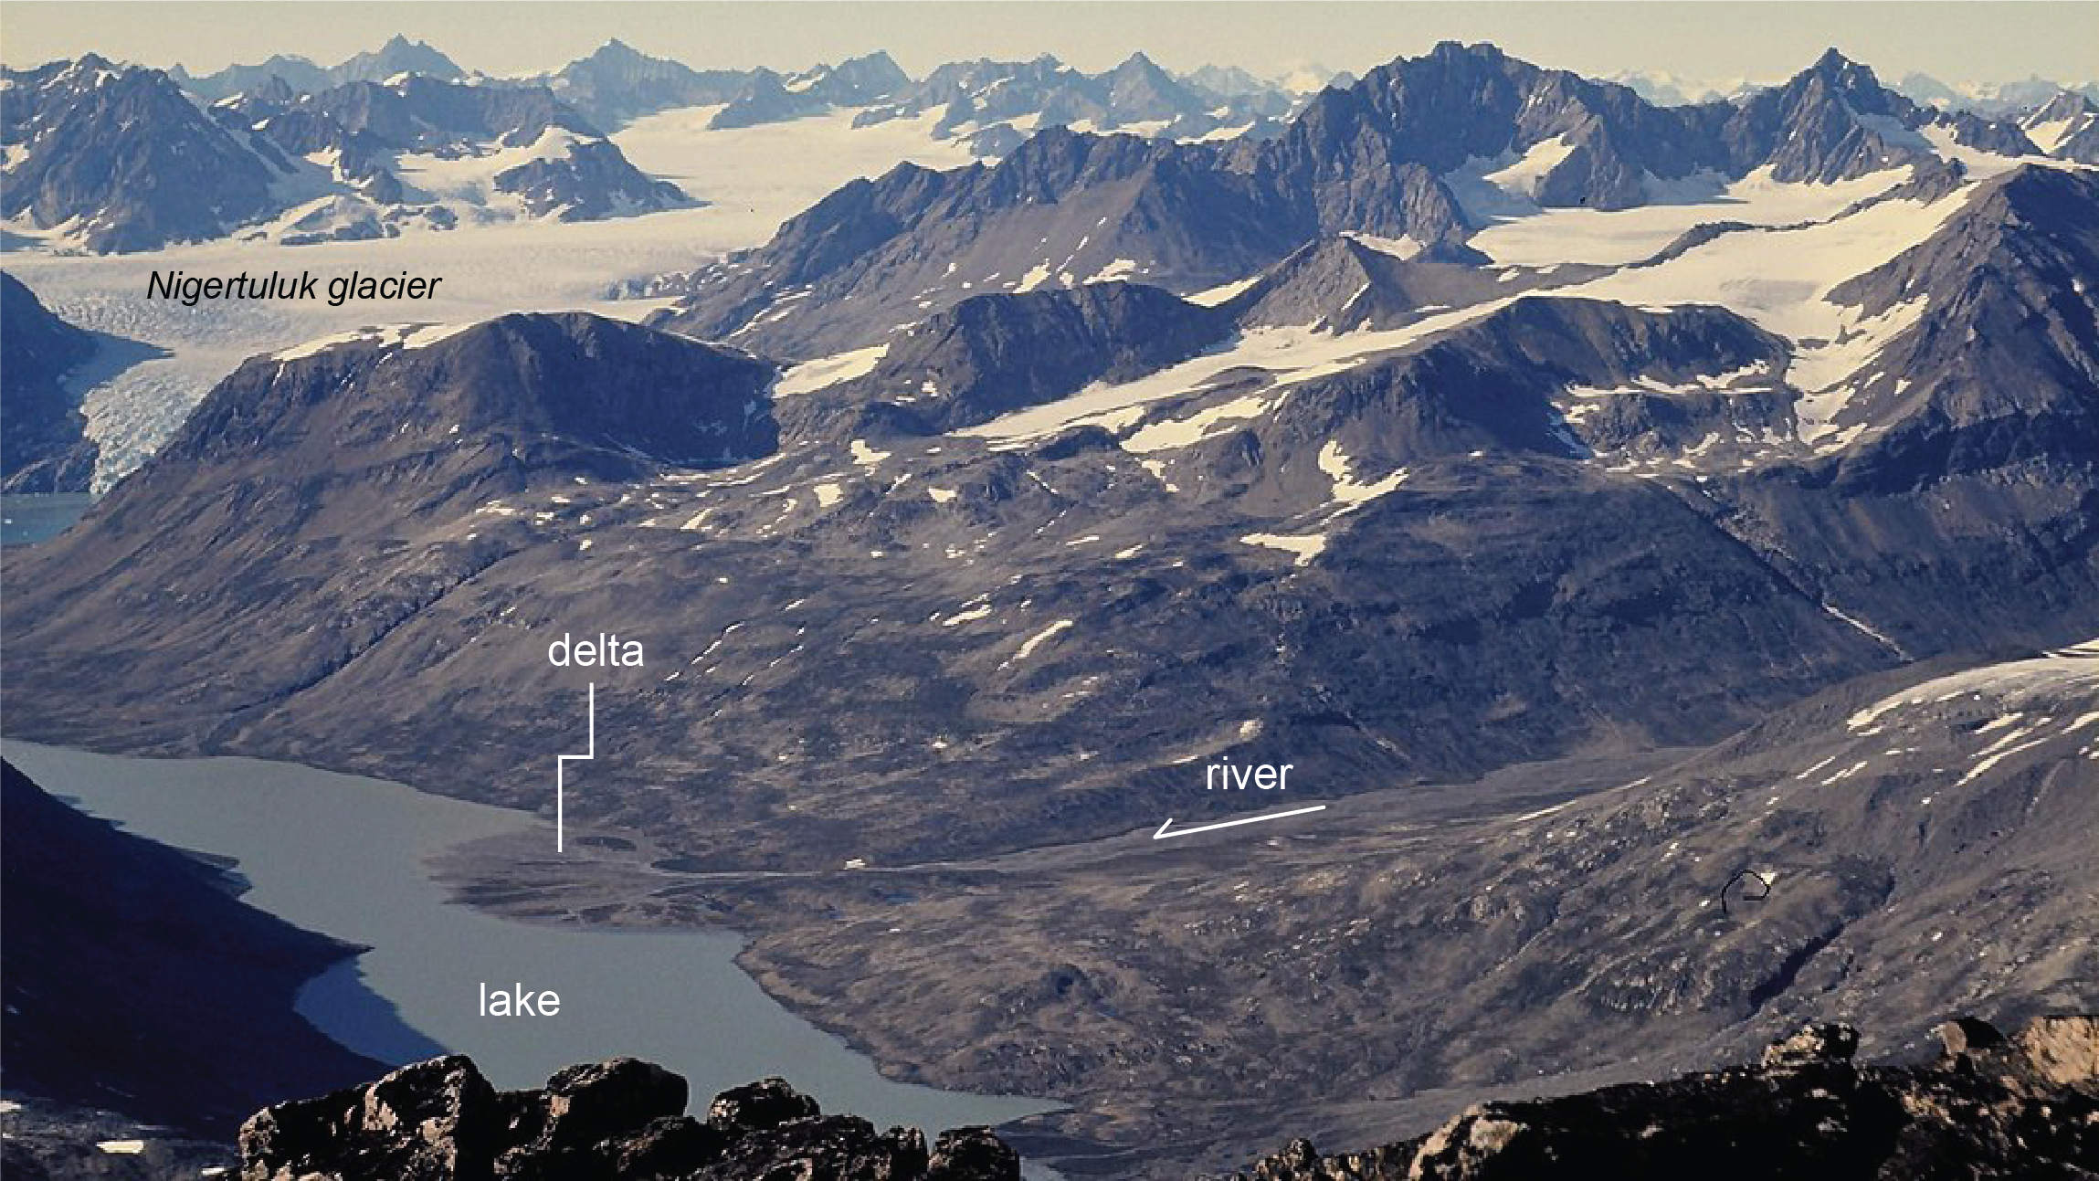
4. Depositional Features
i. Delta – when streams empty into still water (lakes/oceans), alluvial fan in water. (Drop their load in the still water.)

Slide 23
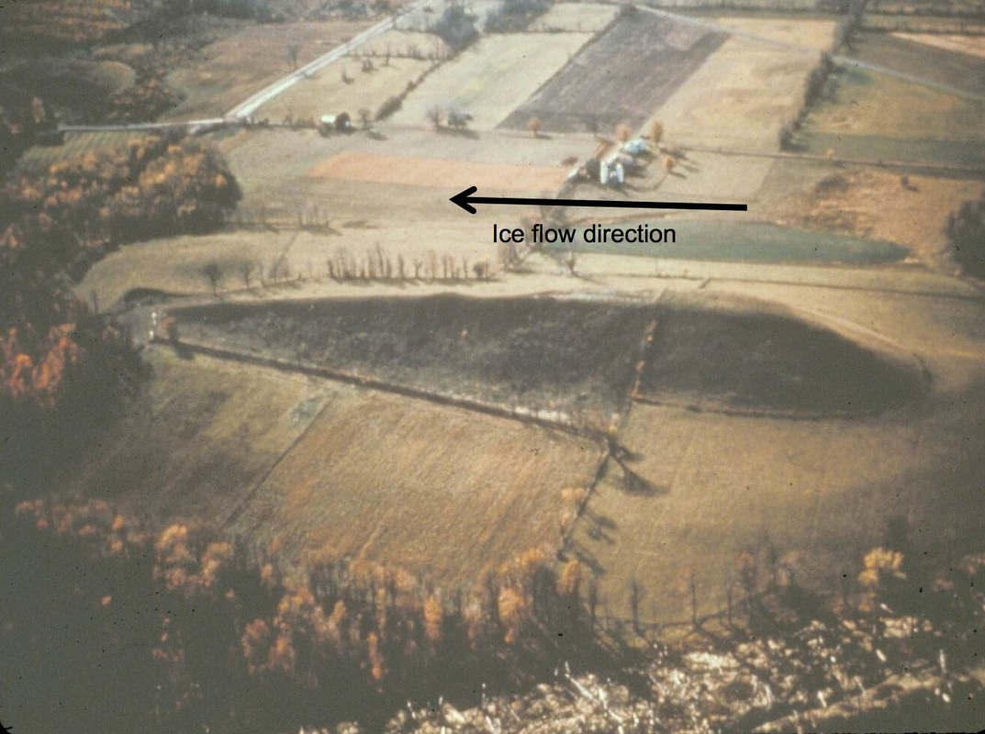
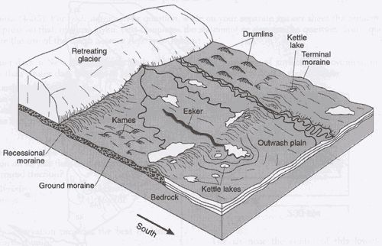
5. Other Features
a. Drumlin – long smooth canoe-shaped hills made of till formed when advancing glacier runs over earlier deposited moraines

Slide 24
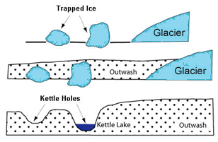
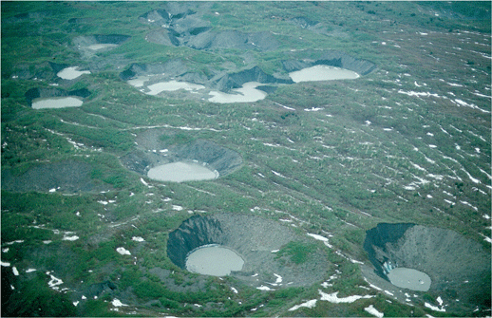
5. Other Features
b. Kettles – circular hollows on terminal moraines and outwash plains; large lump of ice left imbedded in outwash material then ice melts leaving a hole.

Slide 25
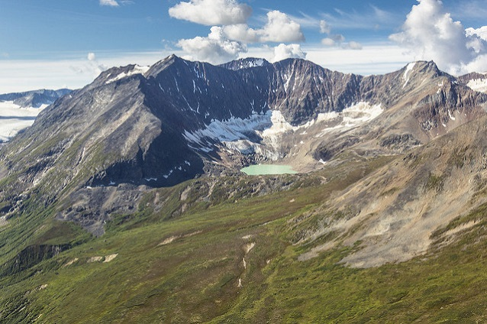
6. Glacial Lakes
a. Cirque Lake – formed when water fills the cirque basin left by alpine glaciers, also called tarns. Ex Lake Louise

Slide 26
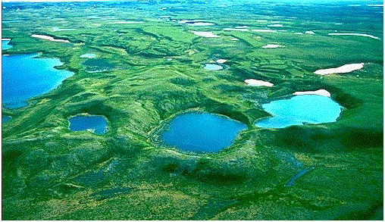
6. Glacial Lakes
b. Kettle Lake – formed when water fills kettles

Slide 27
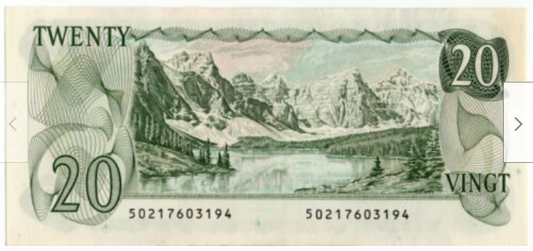
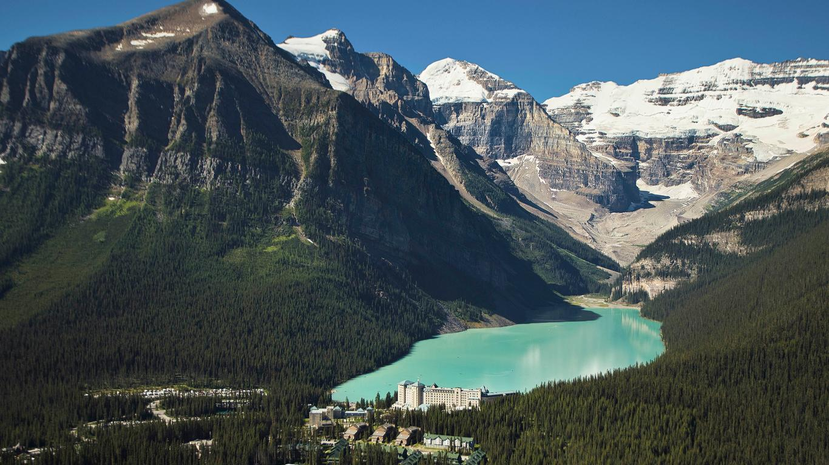
6. Glacial Lakes
c. Moraine damned lake – river valley (used to be a glacial valley) blocked by moraines. Ex Moraine Damned Lake on old $20 bill. And Lake Louise. Near Banff.
Do Purple page 21 now; go over together

Slide 28
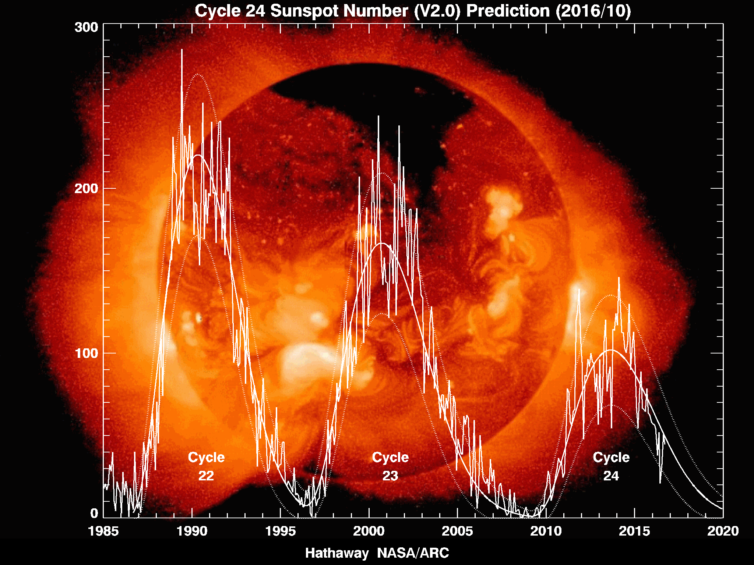
7. Hypotheses regarding the origin of ice ages / global warming
External
a. Significant changes in sun’s energy output.
  Cycles of sunspot activity cause fluctuations but would have to be 10 times larger and way longer than what we see I the current 11 year cycle.
  Lack of evidence, can’t prove or disprove

Slide 29
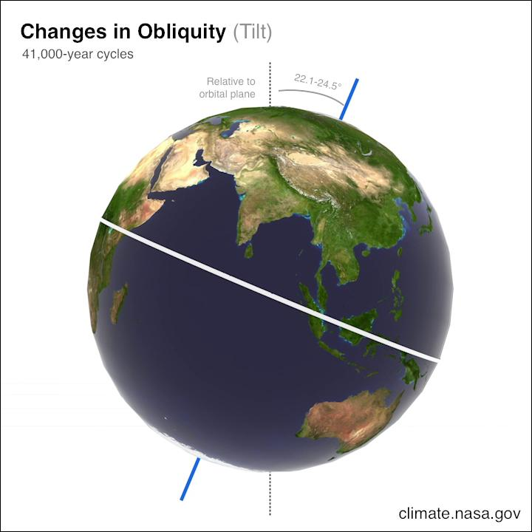
7. Hypotheses regarding the origin of ice ages / global warming
External
b. Variation in the tilt of Earth’s axis.
  Polar region might become cold enough for large ice sheet to develop
  For Pleistocene ice age there seems to be a correlation, but tests can’t be done for earlier ones.

Slide 30
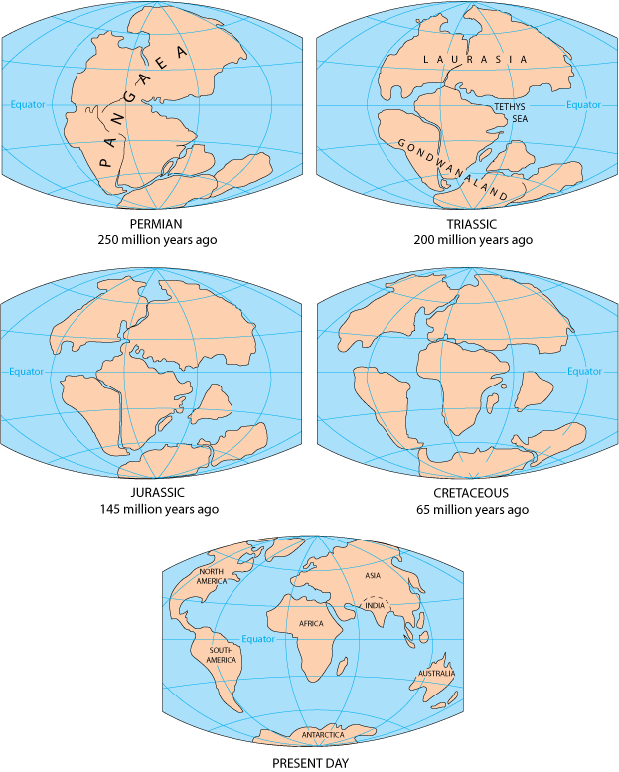
7. Hypotheses regarding the origin of ice ages / global warming
Earth-based
When Pangea broke up the ocean circulation was blocked so warm equatorial water couldn’t get to the poles.
  Accounts for Pleistocene but not ice ages prior to break up of Pangea
  Can’t explain glacial advance and retreat in one ice age

Slide 31
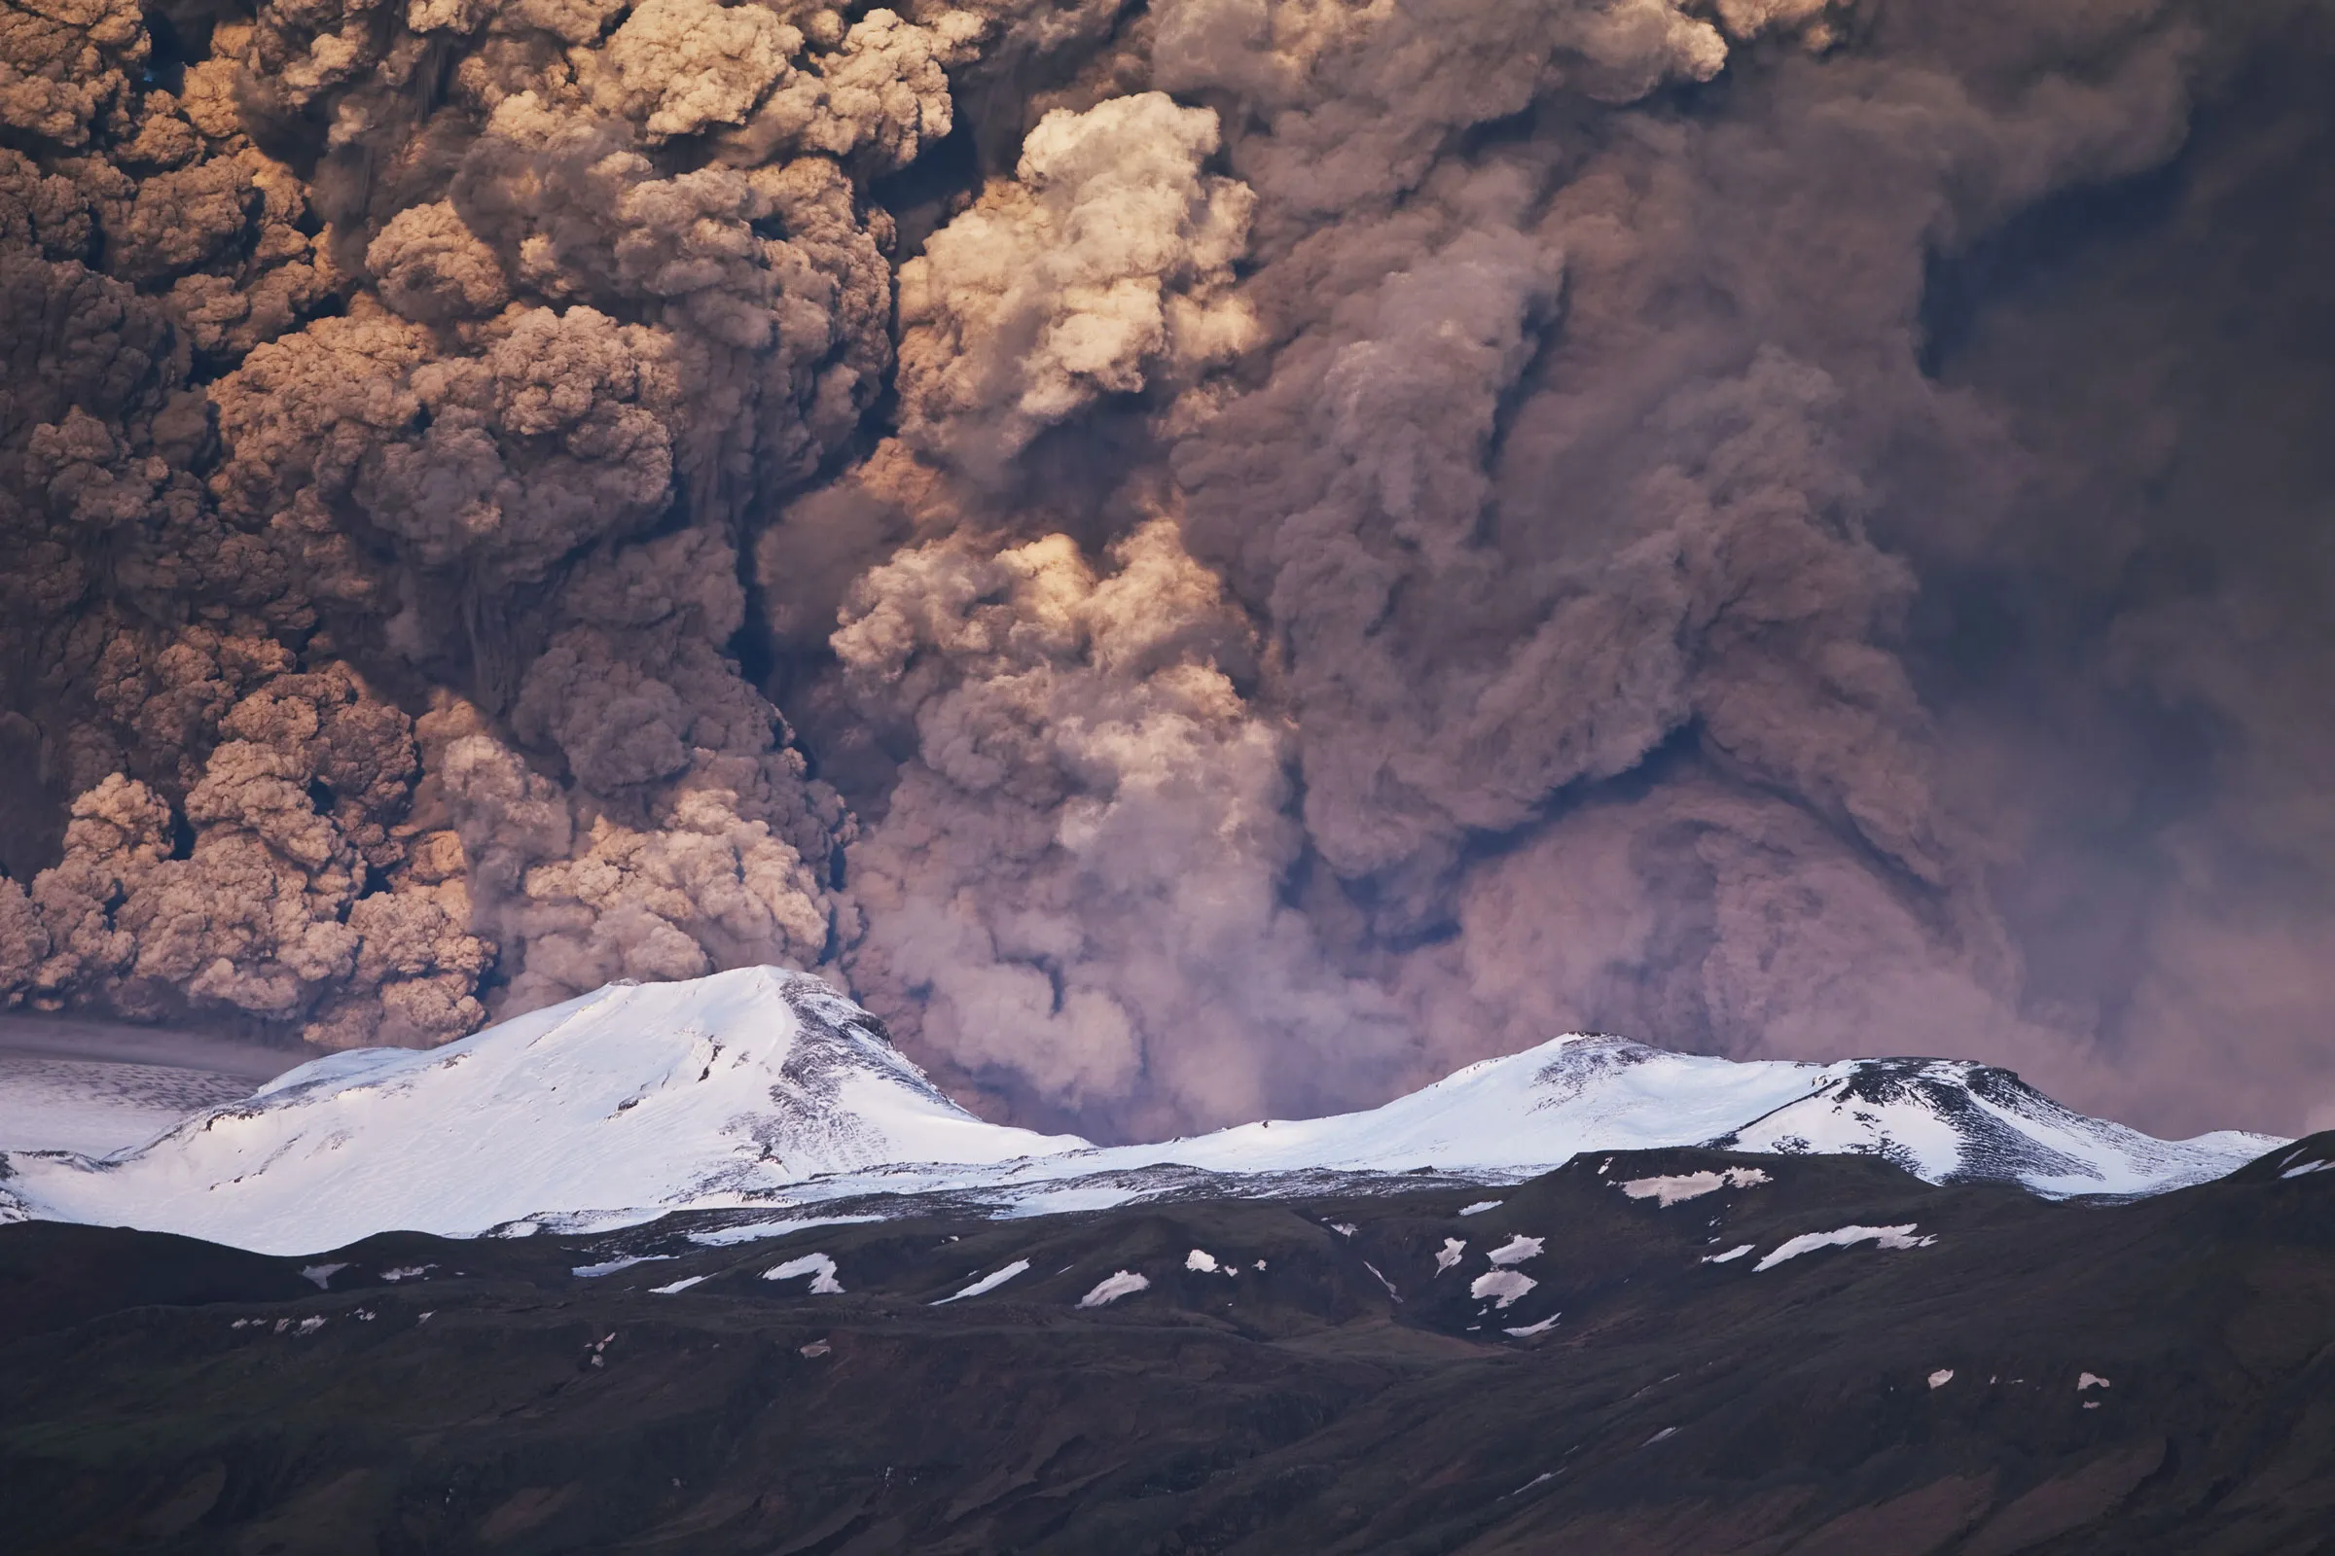
7. Hypotheses regarding the origin of ice ages / global warming
Earth-based
Blocking of incoming solar radiation by something in the atmosphere.
  Ex: Volcanic ash – in past Earth was more active volcanically so maybe enough dust for long enough led to cold enough temperatures to cause ice sheets to form.

Slide 32
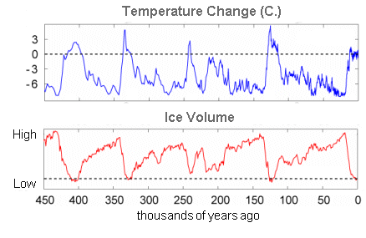
7. Hypotheses regarding the origin of ice ages / global warming
None of the above accounts for all the ice ages. It is an incomplete list too; human activity may have an effect, but not much (especially not for previous ice ages). Something larger is at work!

Slide 33
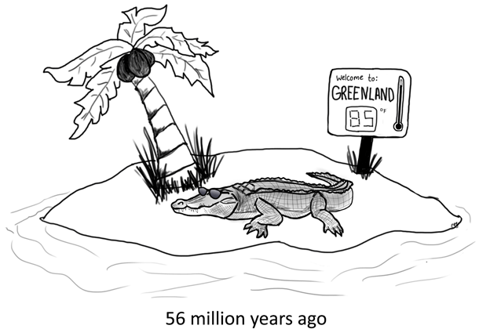
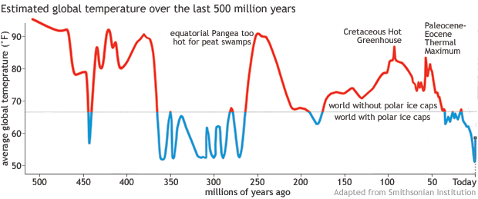
Video: Understanding Natural Climate Cycles
https://www.youtube.com/watch?v=qKY7AN3tB_s (5 min)
Source: https://www.climate.gov/news-features/climate-qa/whats-hottest-earths-ever-been

Slide 34
Comparing Sediments
 | Round? | Sorted? | Chem Weathered? | Max size | Other | Sedimentary Features
Streams
Glaciers |  |  |  |  | Normal → Stream involved →
Wind

Slide 35
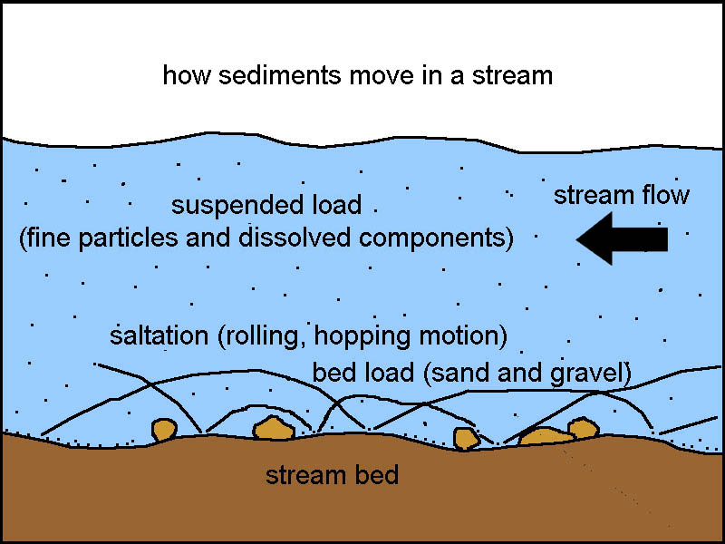
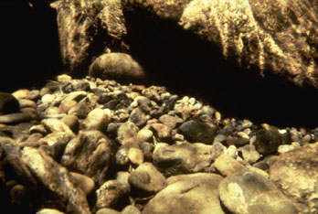
Comparing Sediments: Streams
 | Round? | Sorted? | Chem Weathered? | Max size | Other | Sedimentary Features
Streams | round | Well sorted | Yes | Medium | Smooth | Meanders, deltas, ripple marks
Glaciers |  |  |  |  | Normal → Stream involved →
Wind

Slide 36
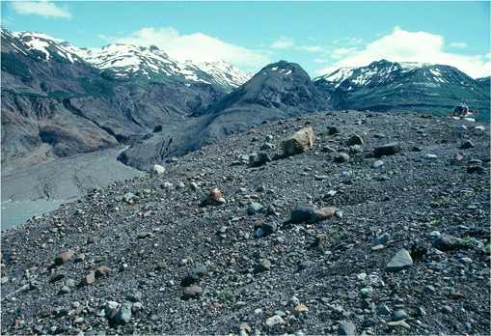
Comparing Sediments: Glaciers
 | Round? | Sorted? | Chem Weathered? | Max size | Other | Sedimentary Features
Streams
Glaciers | angular | Not | No | Large | Normal → Stream involved → | Moraines, erratics
 | round | Well sorted | Yes | Medium |  | Kame, esker, outwash
Wind

Slide 37
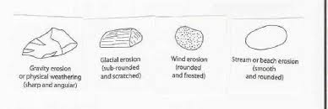
Comparing Sediments: Wind
 | Round? | Sorted? | Chem Weathered? | Max size | Other | Sedimentary Features
Streams
Glaciers |  |  |  |  | Normal → Stream involved →
Wind | round | Very well sorted | No | Small | Pitted | Dunes
Abrasion – sand blasting, grinds rocks (wind or streams)

Slide 38
Comparing Sediments
 | Round? | Sorted? | Chem Weathered? | Max size | Other | Sedimentary Features
Streams | round | Well sorted | Yes | Medium | Smooth | Meanders, deltas, ripple marks
Glaciers | angular | Not | No | Large | Normal → Stream involved → | Moraines, erratics
 | round | Well sorted | Yes | Medium |  | Kame, esker, outwash
Wind | round | Very well sorted | No | Small | Pitted | Dunes
Abrasion – sand blasting, grinds rocks (wind or streams)

Slide 39
Notes finished
Practice questions from white and purple workbooks:
  White: pg 9 to 13 – complete any not finished yet
  Purple: pg 22 to 28 – complete any not finished yet

