Slide 1
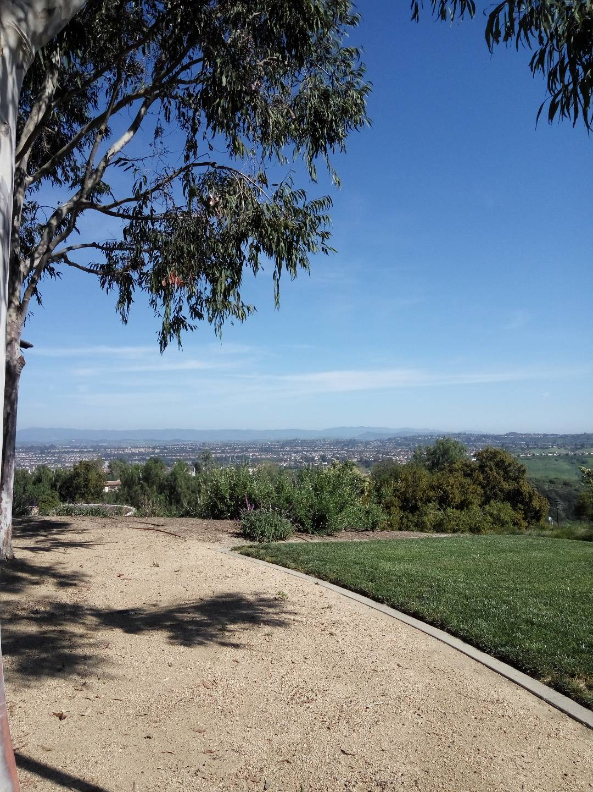
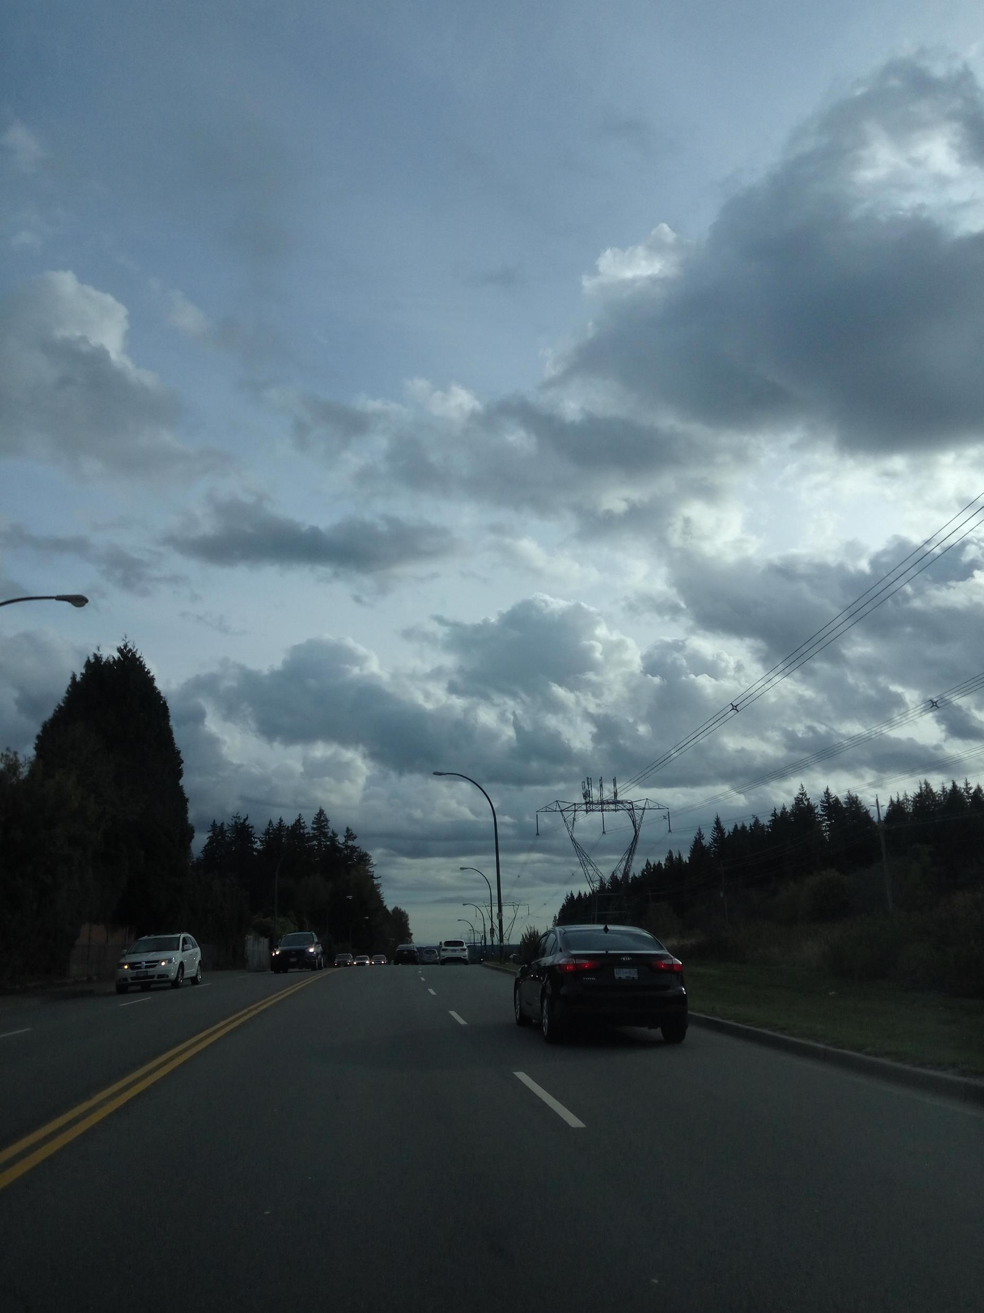
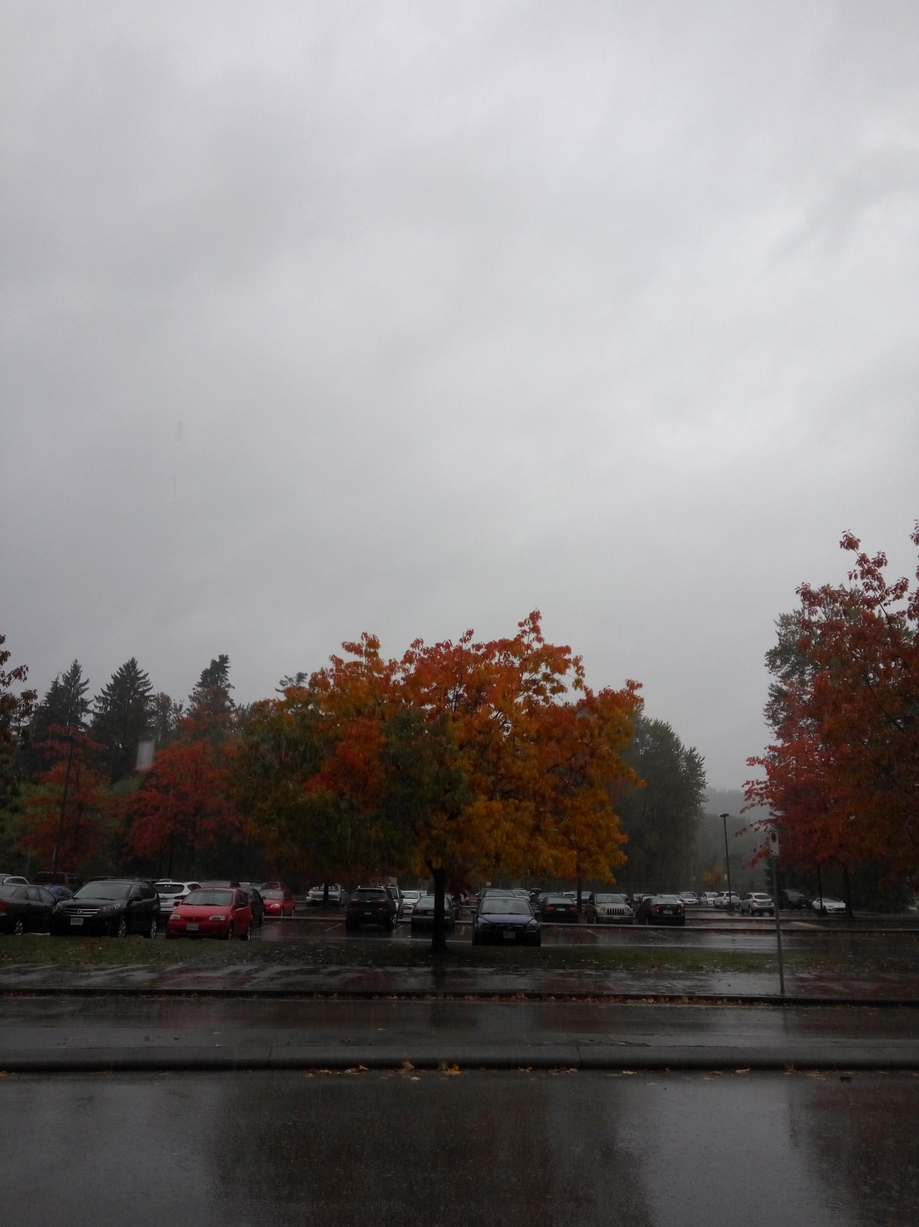
Cloud Project
Max Lau

Slide 2
Types: Cirrus
Took on 10-17-2017 at Como lake ave (3:40 P.M)
I believe that it is a cirrus clouds because it is thin, white feathery appearance and it was a fair weather.
This picture was the only picture of Cirrus clouds and I was able to take this phot because my team and I went for a jog. At the end, I realized that there was a cirrus clouds.

Slide 3
Type: Cumulus
Took on 10-17-2017 on Como lake ave (5:00 P.M)
I believe that it is a cumulus clouds since they are seams fluffy cottonballs and some has flat bottom.
I was taken on the way home from soccer practice and my mom was talking about clouds, which reminded me about taking a photo of the clouds.

Slide 4
Type: Nimbostratus
Took on 10-18-2017 Riverside Secondary School (12:30 P.M)
I belive that these clouds are nimbostratus clouds since it was raining and it looked like featurless, low clouds covering the entire sky. It was gray as well.
This picture was taken when before the field trip. I was able to take this phot before the bus arrived.

Slide 5
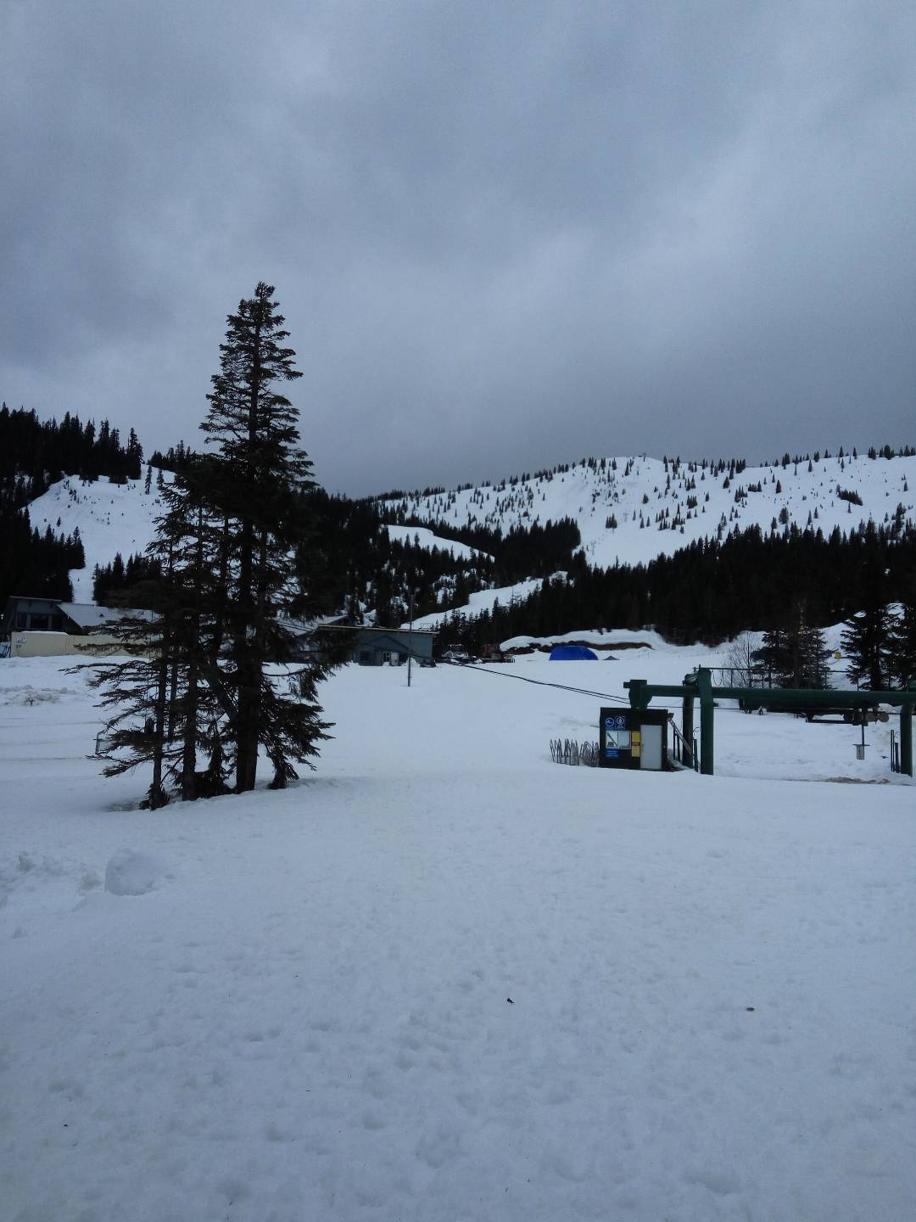
Type: Stratus
Took on 03-15-2017
I believe that this is stratus clouds since it was gray, low clouds covering the sky.
I took this picture when I was part of a commercial shooting for a Japanese commercials for the Paralympics.

Slide 6
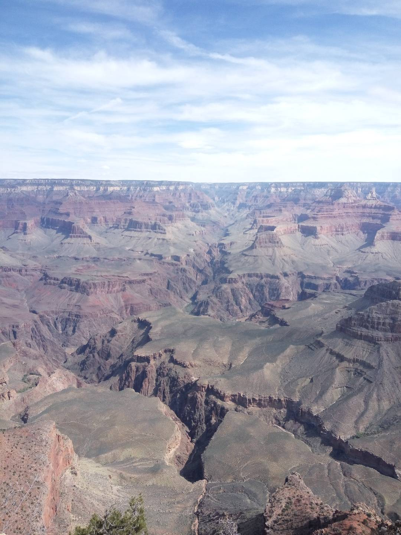
Type: Cirrus
Took on 03-21-2017 at Grande Canyon
I believe that this is Cirrus because it has a feathery appearance.
This picture was when my family and I went to see the Grand Canyon. It was really beautiful and when we were able to see the sunset, it was even more beautiful.

Slide 7
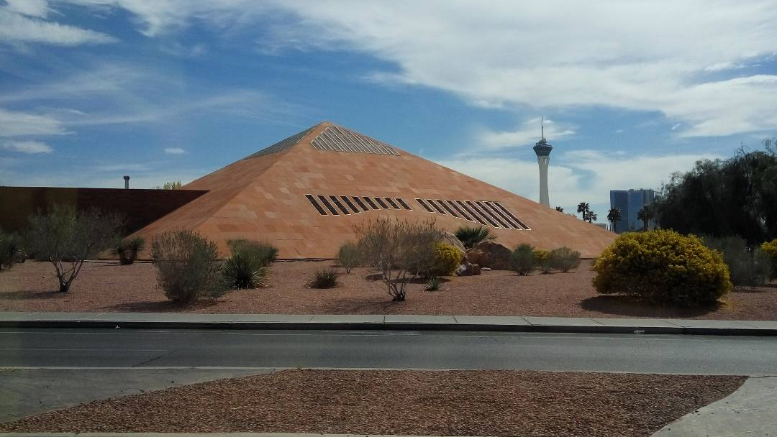
Type: Cumulus
Took on 03-19-2017
I believe that these clouds are cumulus since they look like white fluffy cotton balls.
This picture was taken when I was in Los Vegas with my family. It was the same day when I arrived and it was really hot.

Slide 8
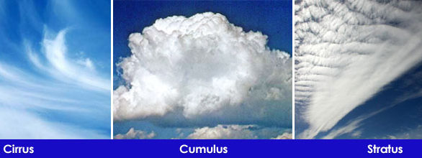
The End

