Slide 1
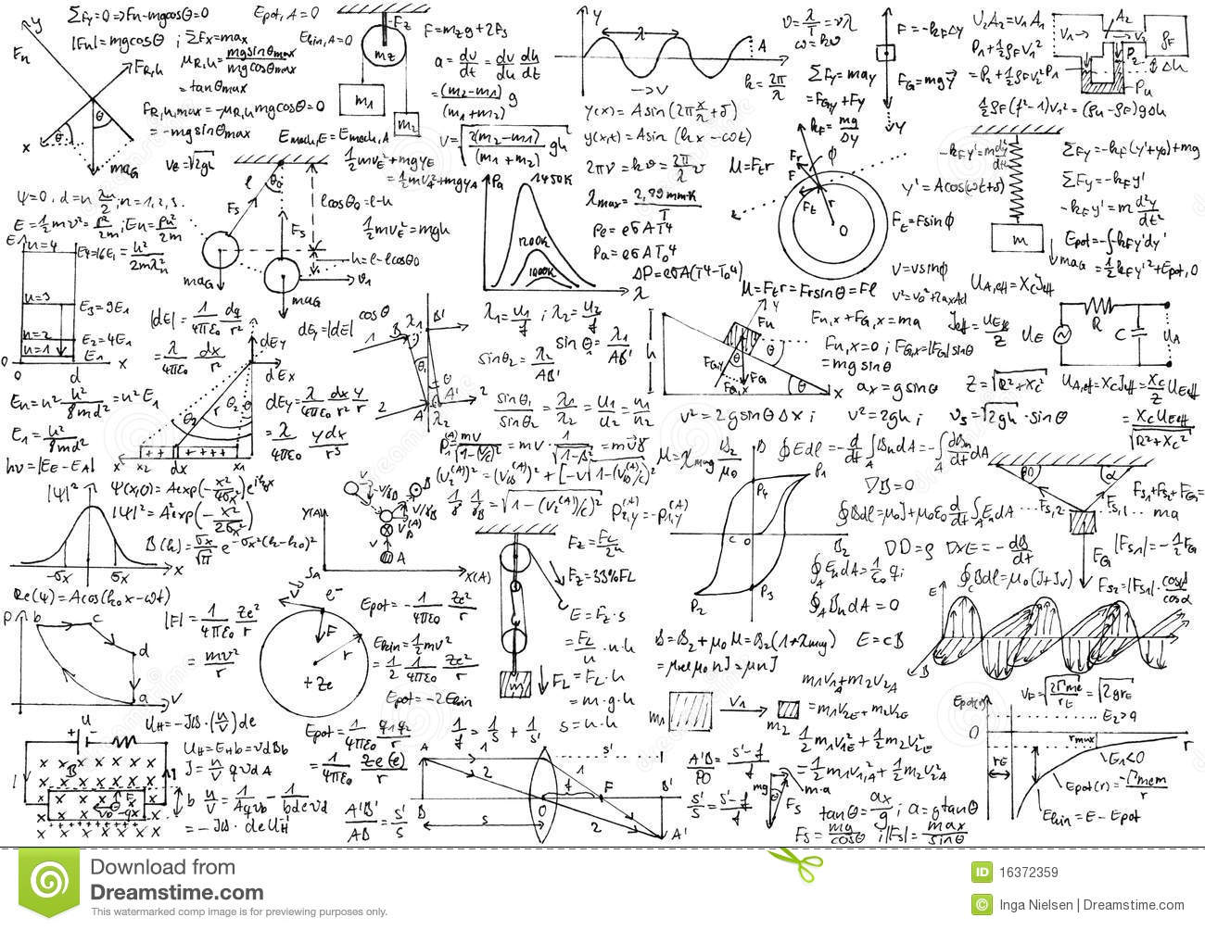










THE GREAT 2/3-TERM
REVIEW GAME

Slide 2
RULES
For each question, your team will have a certain amount of time to collaboratively solve the question.
Once the time is up, I will call out a card (A, K, Q, J). The team member who matches that card will then be responsible to share their team’s answer on their section of the class whiteboard.
Points are awarded based on this answer.
If teams collaborate (verbal and non-verbal) past the allocated time, they forfeit their right to participate in answering the question.
The team will most points at the end of the game, gets a bonus point on their 2/3-Term
No workbook or internet reference. Only the purple sheets.

Slide 3
Kinematics
A ball is launched at a 33º angle from a 33 m high cliff at 33 m/s. How far from the base of the cliff will the ball land?
Notes:
120 m

Slide 4
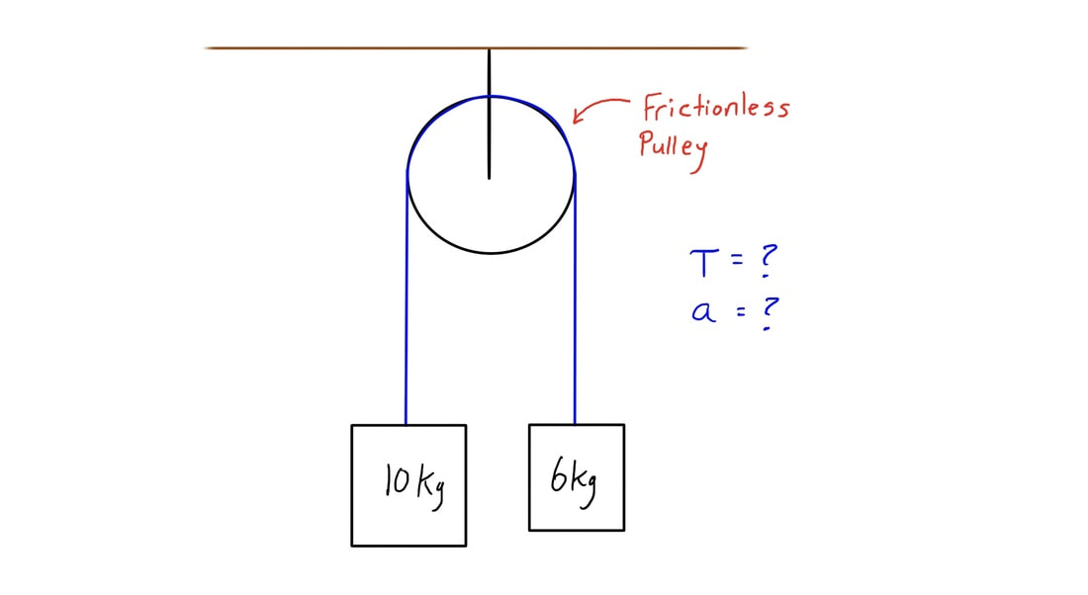
Dynamics
Notes:
a = 2 m/s, T = 70 N

Slide 5
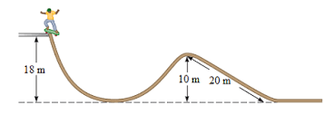
Energy
If the 52 kg skateboarder starts from rest, what is his speed at the top of the 10.m hill. Assume he loses 536 J of energy to friction.
Notes:
v = 12 m/s

Slide 6
Momentum
Without finding acceleration, calculate the time an average net force of 225 N must act on a 1.0 x 10³ kg object to change its velocity from 2.0 m/s east to 5.0 m/s west.
Notes:
t = 31 s

Slide 7
Momentum
A 15.0 kg object is moving east at a velocity of 7.0 m/s when it collides with a 10.0 kg stationary object. After the collision, the 15.0 kg object is travelling at a velocity of 4.2 m/s 20.0º S of E. What is the velocity of the 10.0 kg object after the collision?
Notes:
5.1 m/s [25º N of E] (pg 230 #5)

Slide 8
Relativity
What starting mass would be required to produce 5.0x10²⁵ J of energy if only 60.% of the starting mass can be converted to energy?
Notes:
m= (5.0x10²⁵ J) / (0.6xc^2) = 9.3x10⁸ kg

Slide 9
Relativity
You are playing catch with your friend on a train moving at 0.95c to the East. You throw the ball towards your friend (who is at the back of the train) at a velocity of 0.34c relative to you.
What is the velocity of the ball according to your friend.
What is the speed of the ball according to an observer standing on a platform outside?
Notes:
0.34c (towards them or away from the thrower)
0.90c (no need for direction since we are looking for speed)

Slide 10
Relativity
What is the velocity (in m/s) of a rocket that an observer on Earth measures to be 2.5 m while it is moving but was measured to be 9.3 m before it was launched?
Notes:
2.9 x 10^8 m/s

Slide 11
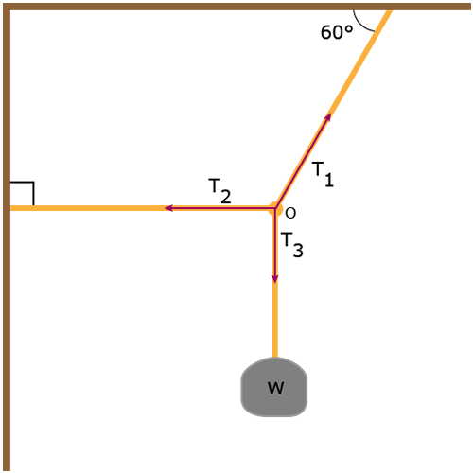
Equilibrium
If w = 444 N, what is T₁?
Notes:
510 N (technically should be 1 sig fig, but use 2)

Slide 12
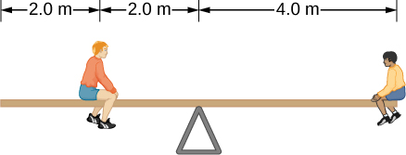
Equilibrium
If the left-hand person weighs 750 N, what is the mass of the right-hand person? (Uniform beam.)
Notes:
38 kg

Slide 13
Circular Motion
A string requires a 186 N force in order to break. A 1.50 kg mass is tied to this string and whirled in a vertical circle with a diameter of 3.80 m. What is the maximum speed that this mass can be whirled without breaking the string?
Notes:
14.7 m/s (pg 64 #5)

Slide 14
Circular Motion
A 1750 kg meteorite has a velocity of 1.00 x 10³ m/s heading directly toward the moon when it is 15,000 m above the moon’s surface. What is the speed of the meteorite when it hits the moon’s surface? (Technically the instant before it hits the surface.)
Notes:
1.0 x 10³ m/s (pg 90 #4)

Slide 15
Circular Motion
What is the mass of a planet that has an escape speed of 9.0 x 10³ m/s and a radius of 7.2 x 10⁶ m?
Notes:
4.4 x 10²⁴ kg (pg 92 #3)

Slide 16
DONE!

